Slide 1
Practical AI (ST1508)
DAAA/FT/2B/01

Slide 2
Business understanding
GoBest Cab Operates in a competitive ride-hailing market with a focus on customer safety and satisfaction
Industry trends show the critical role of data in service improvement and safety assurance
Aim: Identify patterns to predict and mitigate risks for safer, more reliable services

Slide 3
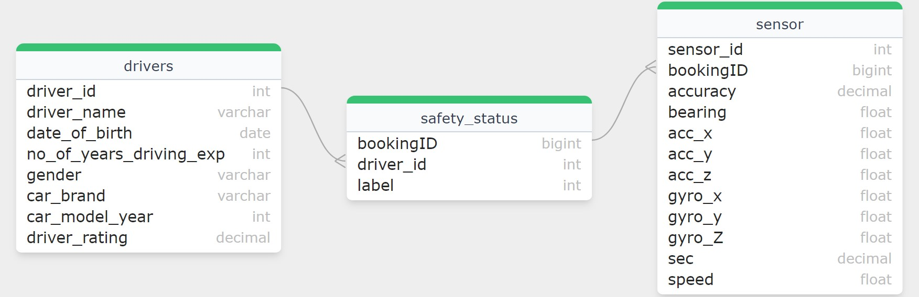
Data ingestion
The data was ingested from CSV files into the corresponding tables using the ‘BULK INSERT’ command which were loaded sequentially.

Slide 4
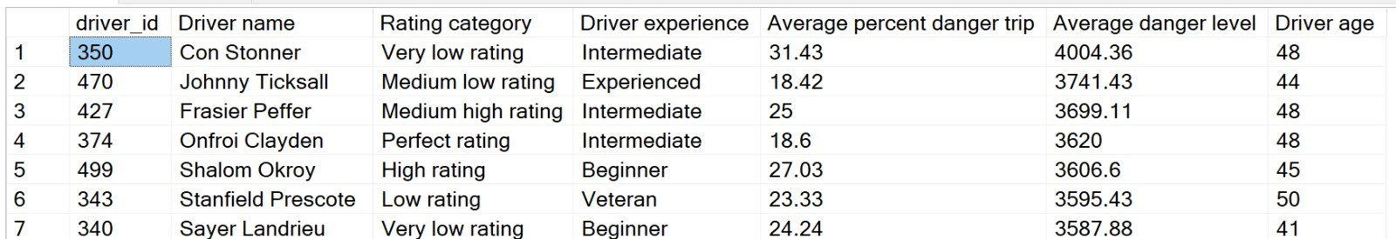
SQL Query 1
Analyse driver safety by combining various metrics like sensor data from trips, driver ratings, experience, and age

Slide 5
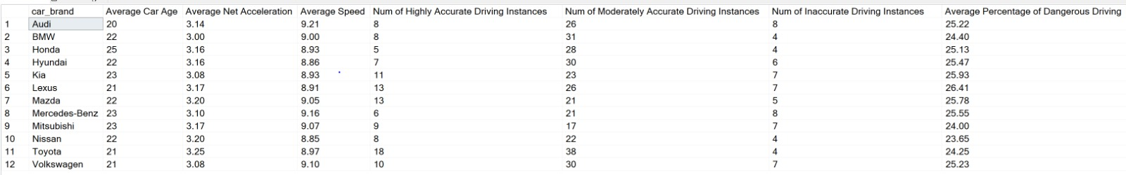
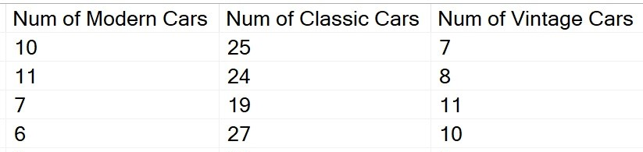
SQL Query 2
Analyse various aspects of driver and vehicle performance, focusing on safety, accuracy, and the age category of vehicles, grouped by car brand

Slide 6
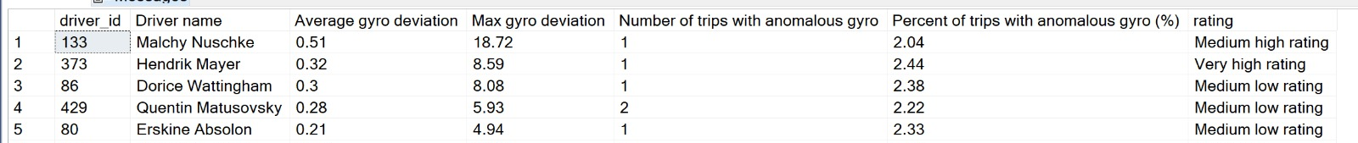
SQL Query 3
Analyse driver performance based on gyroscope data from their trips, specifically focusing on deviations from average gyroscope readings

Slide 7
Preparation and preprocessing
Data was extracted using SQL queries using SQLAlchemy
Preprocessing steps
Outlier Removal: Sensor data was cleaned to remove NaN values and outliers in the ‘sec’ column
Data Interpolation: Missing sensor values were interpolated linearly
Feature Engineering: New columns such as ‘hours’ and ‘total_acceleration’, were created from existing sensor data
Label Encoding: Driver names were standardized to string data type, categorical variables like ‘gender’ and ‘car_brand’ were label encoded for uniformity
Age Calculation: Drivers’ ages were calculated from their birth dates
Safety Data Preprocessing: Safety data types were converted to Boolean for clearer interpretation

Slide 8
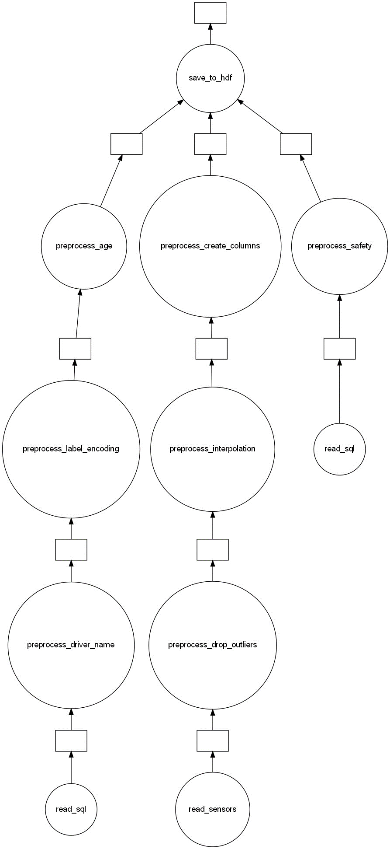
Save to hdf (.h5)
Preprocess age
Preprocess safety
Preprocess create columns
Preprocess label encoding
Read SQL
Preprocess driver name
Preprocess interpolation
Preprocess drop outliers
Read SQL
Read Sensors

Slide 9
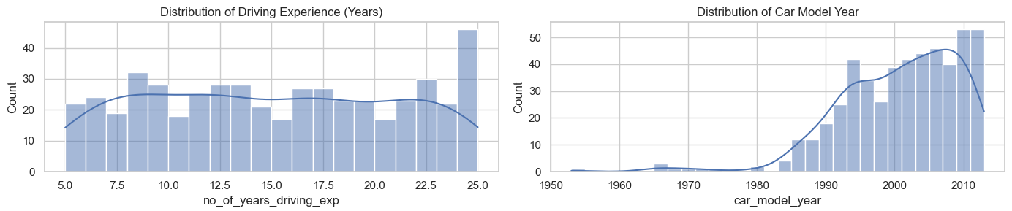
EDA insights
Diverse range of experience levels among the drivers in the dataset with 25 being the most common
Vehicle model years are skewed towards newer models, with a peak around the year 2000
general market trend of drivers preferring newer models

Slide 10
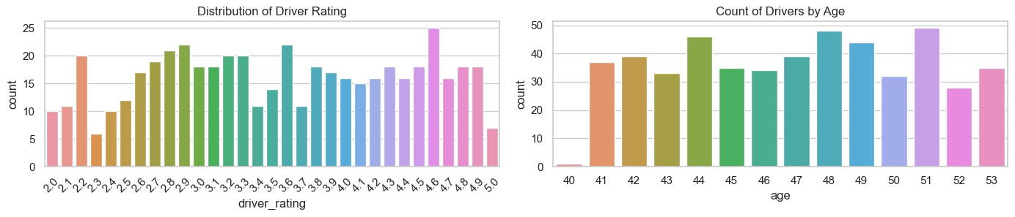
EDA insights
Distribution of driver ratings indicates a multimodal distribution with peaks at ratings of 2, 3, and 4.
Imply a rating system where the majority of drivers are rated above average, with fewer drivers at the extremes of the scale.
Distribution across ages appears somewhat uniform with slight variations, indicating a diverse age range among drivers

Slide 11
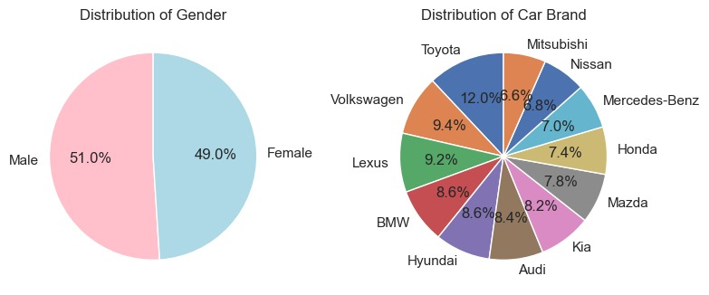
EDA insights
Diverse spread across various brands
Distribution of genders within the driver dataset, with two nearly equal portions

Slide 12
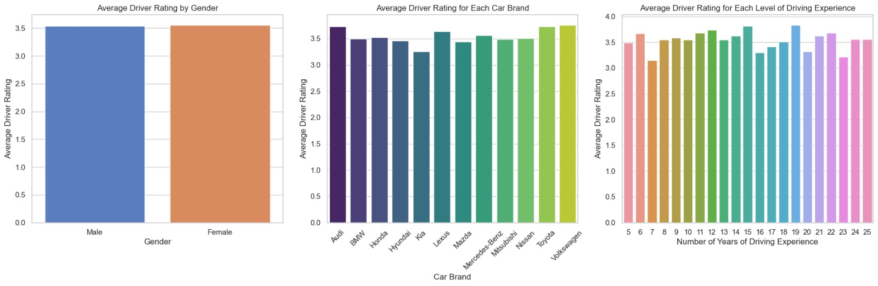
EDA insights
Slight variations in ratings between brands
Suggests that car brands may correlate with slightly higher or lower driver ratings
No clear trend suggesting a direct correlation between years of experience and the average rating
Ratings are even indicating non-biased distribution of ratings across genders

Slide 13
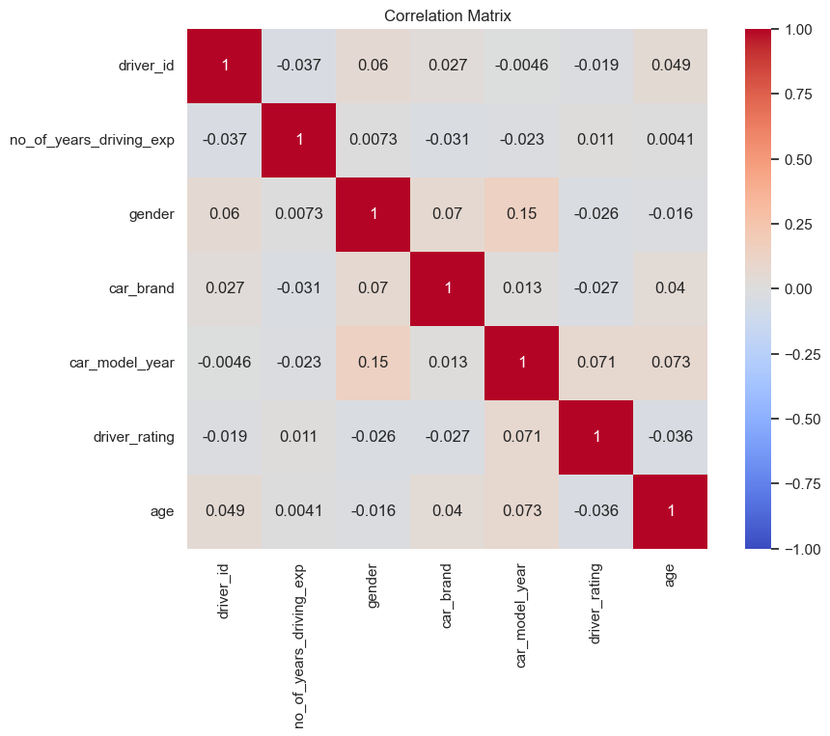
EDA insights
There is no single factor that significantly influences driver ratings

Slide 14
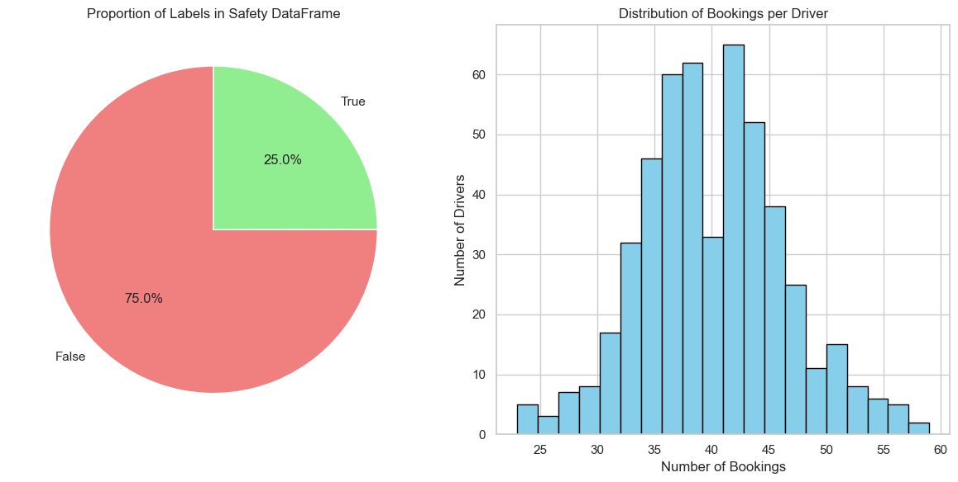
EDA insights
75% of the instances were labelled as 'False', indicating no safety concerns, while 25% were labelled as 'True', which may indicate some safety incidents or issues
Most drivers have between 30 and 50 bookings, with the distribution peaking around this range. This indicates that there is a relatively balanced workload distribution among drivers

Slide 15
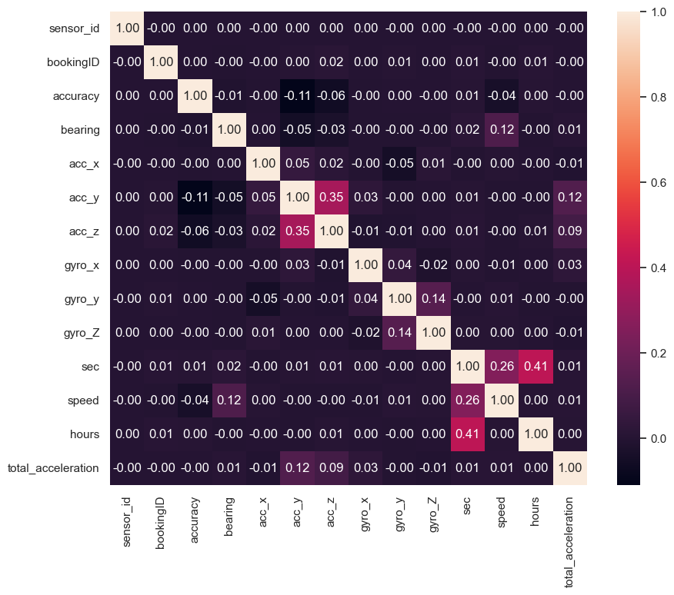
EDA insights
Acceleration Axes: A notable positive correlation is observed between ‘acc_y’ and ‘acc_z’ (0.35), which could indicate that these axes of acceleration are often influenced together during driving events.
Gyroscopic Axes: There is a moderate positive correlation between ‘gyro_y’ and ‘gyro_z’ (0.14), suggesting a relationship between these rotational movements, possibly during turns or manoeuvres.
Time and Speed: The ‘sec’ (time) feature exhibits a positive correlation with ‘speed’ (0.26) and ‘hours’ (0.41), indicating that longer trips might have higher speed readings, possibly due to highway travel or less congested conditions.
Total Acceleration: Interestingly, ‘total_acceleration’ shows a positive correlation with ‘speed’ (0.12), which aligns with the understanding that higher speeds are typically associated with higher dynamic forces.

Slide 16
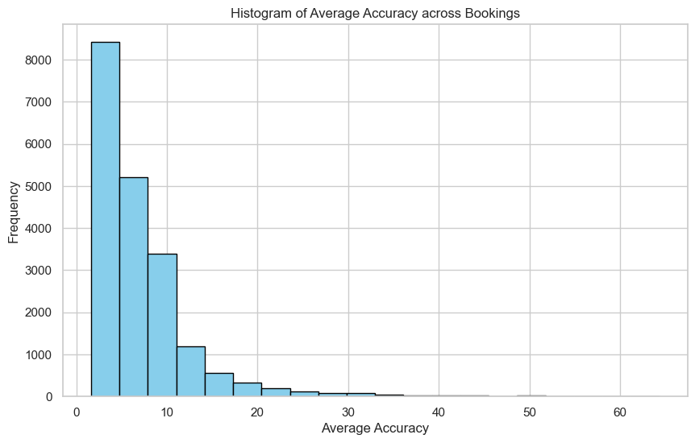
EDA insights
The majority of bookings have an average accuracy within the 0-10 range and a a rapid decline in frequency as the average accuracy value increases
Suggests that the GPS equipment used in the bookings is generally reliable.
The distribution's skewness towards lower accuracy values implies that the instances of poor accuracy are relatively infrequent

Slide 17
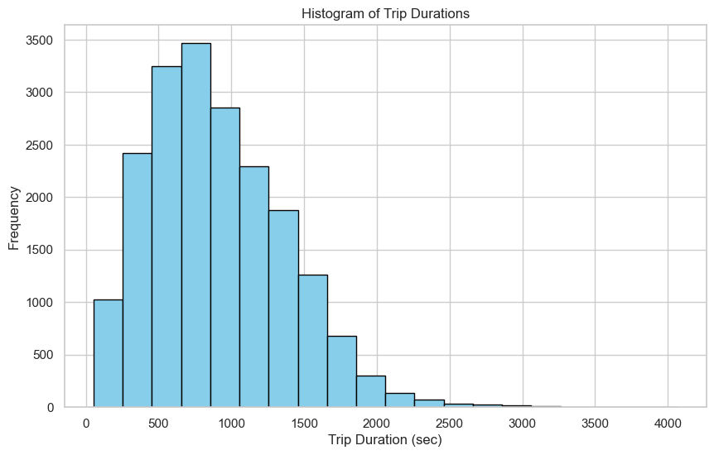
EDA insights
A wide range of trip durations, with the majority of bookings having an average duration of less than 500 seconds.
The frequency of bookings decreases as the duration increases, suggesting that longer trips are less common than shorter ones.

Slide 18
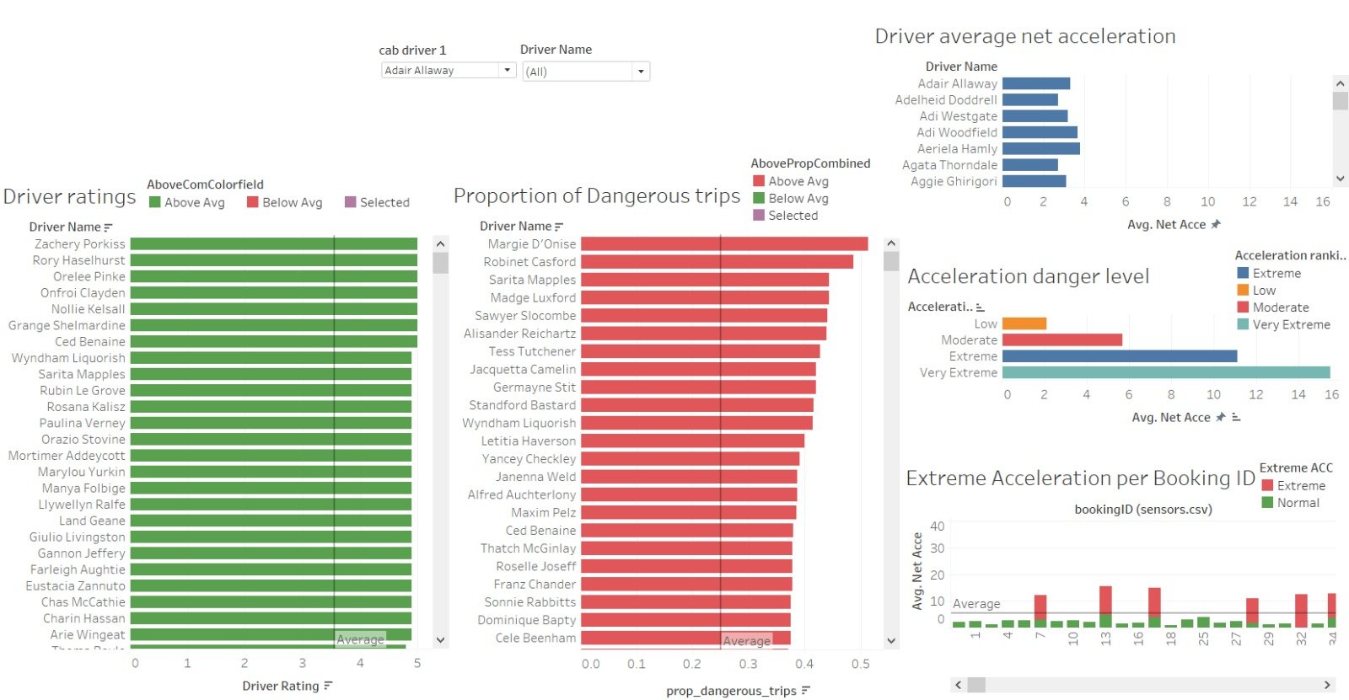
Tableau Dashboard (cab driver)

Slide 19
Tableau insights (cab driver)
Driver Ratings
Acceleration Danger Level
The chart clearly identifies top-performing drivers, which can be useful for recognizing and rewarding good performance, as well as identifying drivers who may need additional training or support.
categorizes average net acceleration into different danger levels providing a clear visualization of how many drivers are engaging in potentially risky driving behaviors based on their acceleration patterns.
Proportion of Dangerous Trips
The bar chart quantifies the proportion of trips that are considered dangerous for each driver.
Extreme Acceleration per Booking ID
Driver Average Net Acceleration
Represent the frequency of extreme acceleration events for individual bookings. It could be used to pinpoint specific instances where intervention might be necessary
displays the average net acceleration for each driver, which can be an indicator of aggressive driving behaviour

Slide 20
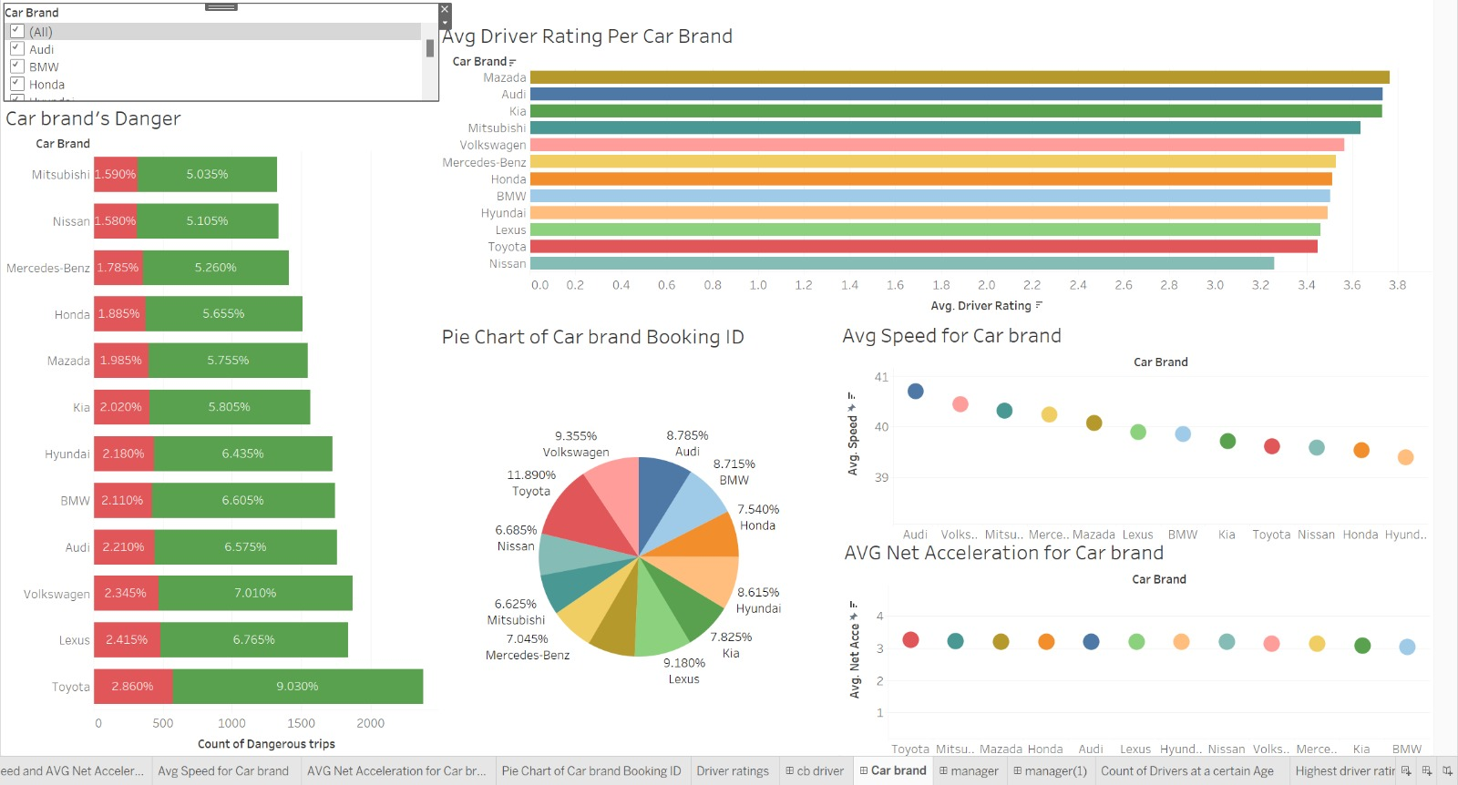
Tableau Dashboard (cab brand)

Slide 21
Tableau insights (cab driver)
Car Brand’s Danger
This bar chart displays two types of danger metrics associated with different car brands. The green bars likely represent a lower level of danger, and the red bars a higher level
Average Speed for Car Brand
plot shows average speed by car brand. There is a spread of average speeds across various brands. Car brands that tend to have higher average speeds might be preferred for certain types of trips
Average Driver Rating Per Car Brand
Shows the count of dangerous trips associated with different car brands. The green and red bars represent different severity levels of danger
Average Net Acceleration for Car Brand
represents average net acceleration for each car brand. Brands that show higher average net acceleration could potentially indicate a tendency for more aggressive driving
Pie Chart of Car Brand Booking ID
Chart illustrates the proportion of bookings for each car brand. The data could be used to identify the most popular or most utilized car brands within the service.

Slide 22
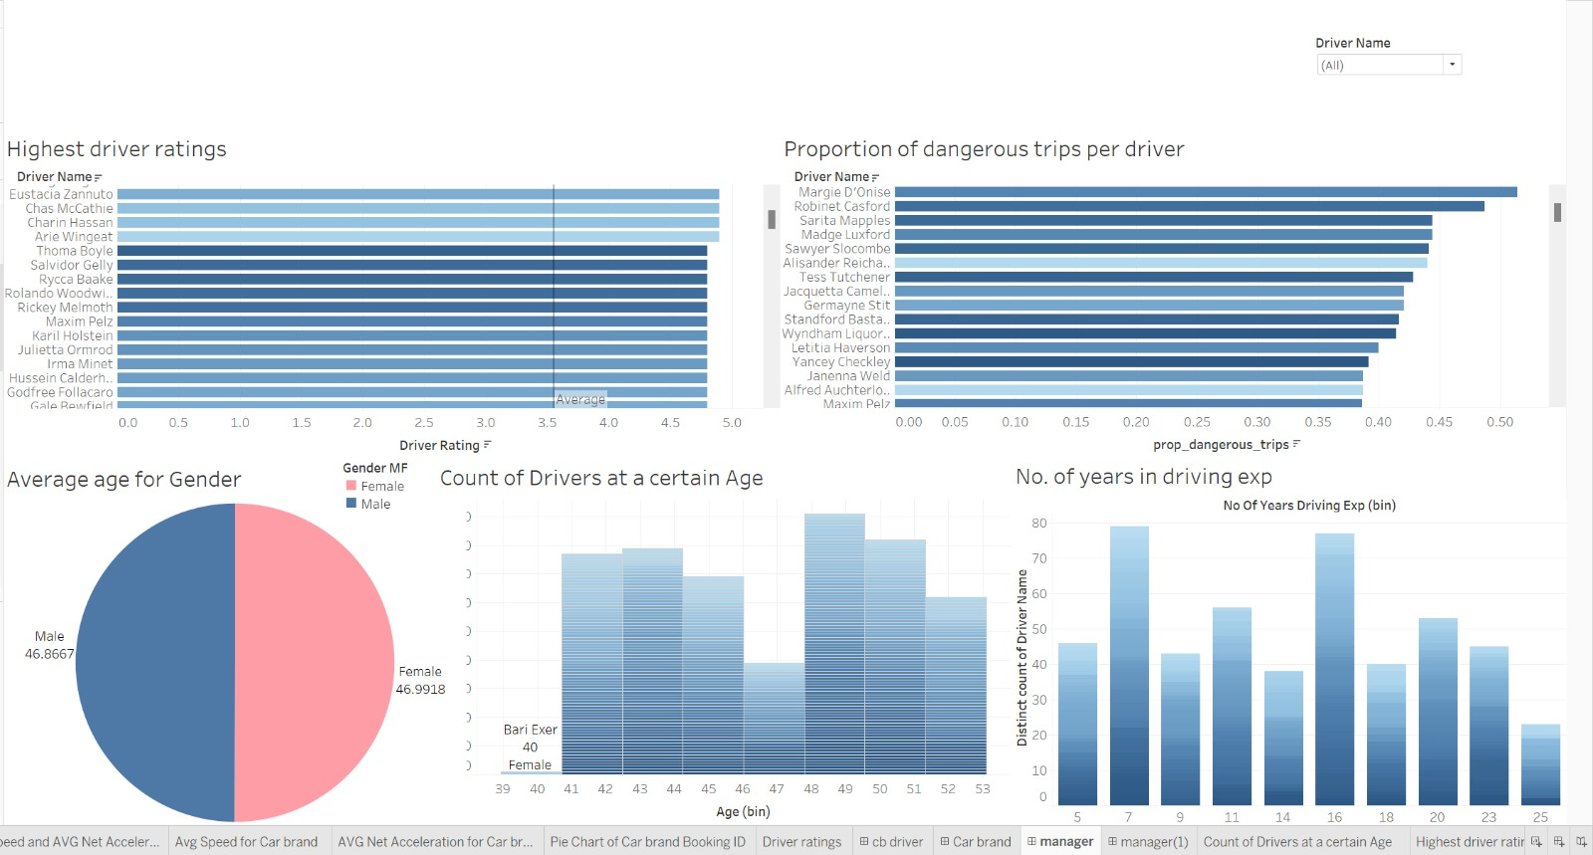
Tableau Dashboard (cab brand)

Slide 23
Tableau insights (cab driver)
Highest Driver Ratings
Shows a range of ratings, with some drivers achieving near the top score. This indicates that there are standout performers who may have best practices that could be shared with other drivers
Count of Drivers at a Certain Age
Shows the distribution of drivers across various age ranges. The peaks of the distribution could indicate common ages for hiring or the ages at which drivers are most available in the job market.
Proportion of Dangerous Trips per Driver
Displays the proportion of dangerous trips for each driver. This could be an area for targeted safety training or further investigation
Number of Years in Driving Experience
Displays the number of drivers according to their years of driving experience. There's a wide range in the level of experience, with fewer drivers at the very high end of the scale. This may indicate a young workforce or high turnover
Average Age for Gender
Shows the average age of drivers, divided by gender. It appears to be a near 50/50 split between male and female drivers

Slide 24
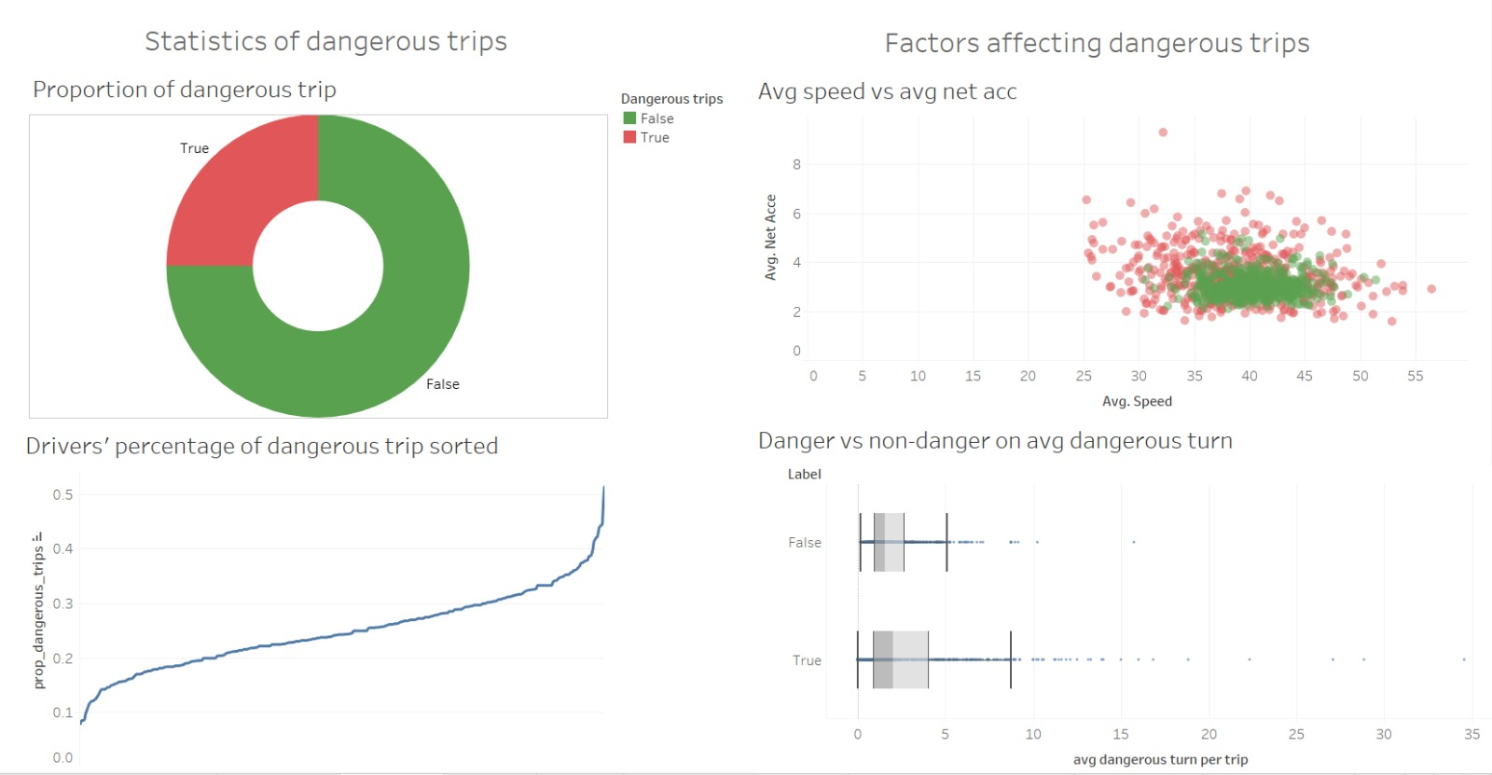
Tableau Dashboard (cab driver)

Slide 25
Tableau insights (cab driver)
Proportion of Dangerous Trips
Average Speed vs Average Net Acceleration
Shows the breakdown of trips into two categories: 'Dangerous' (True) and 'Not Dangerous' (False)
Compares trips on the basis of average speed and net acceleration, with dangerous trips marked in red and non-dangerous in green. The concentration of green in the middle suggests that most trips occur at moderate speeds and accelerations.
Drivers’ Percentage of Dangerous Trip Sorted
Danger vs Non-danger on Average Dangerous Turn
Depicts the cumulative proportion of dangerous trips for drivers, sorted in ascending order. The curve's steepness towards the right suggests that a smaller number of drivers have a disproportionately higher percentage of dangerous trips
Compares the average number of dangerous turns per trip between non-dangerous and dangerous trips. Dangerous trips have a visibly higher median of dangerous turns

Slide 26
Conclusion
GoBest Cab's thorough analysis of journey, driver, and safety data reveals valuable insights through machine learning and interactive dashboards. While most journeys are secure, a specific fleet segment exhibits riskier behavior, prompting targeted safety interventions. Correlations between sensor data and safety incidents suggest opportunities for enhanced driver training and vehicle maintenance. Demographic analysis opens doors for mentorship programs, and variations in vehicle model years impact fleet management and procurement strategy. Driver ratings by brand guide targeted improvements. These insights are crucial for shaping strategic decisions, emphasizing safety, and enhancing customer satisfaction. Continuous real-time monitoring using the developed application is recommended, with future plans including integrating more data and advanced analytics for holistic safety and service quality improvements.

